Slide 1
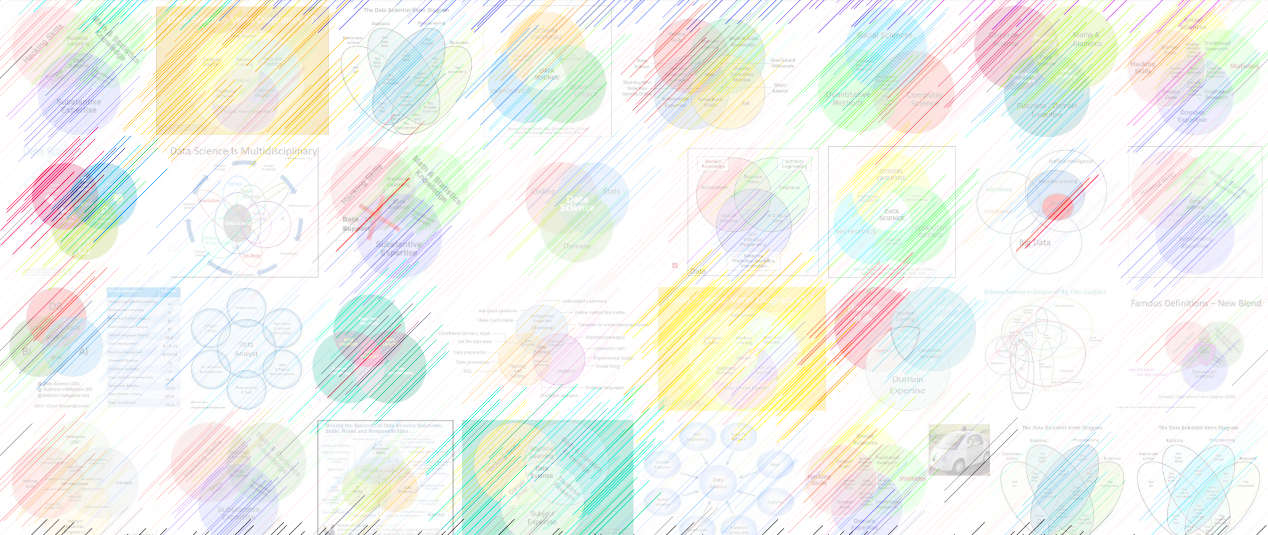

Generative adversarial networks ruining everything since 2014
William Trimble
Spring 2022

Slide 2
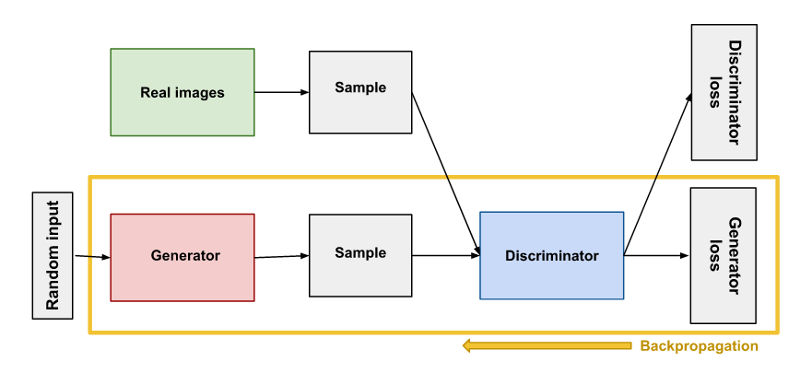

Slide 3
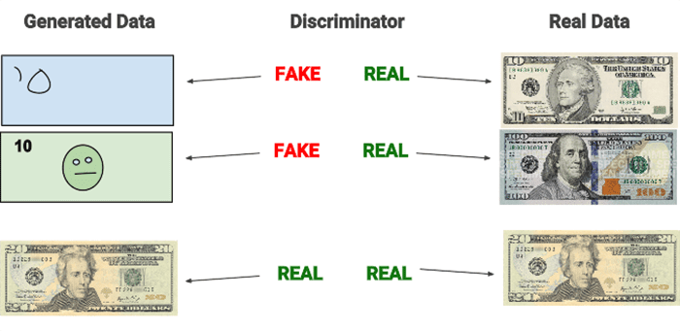

Slide 4
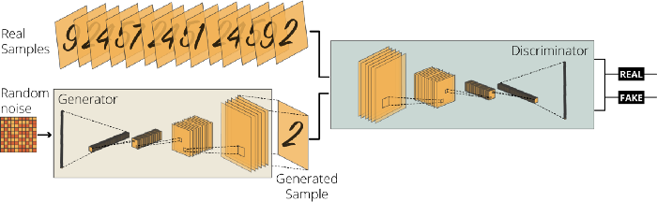
https://towardsdatascience.com/image-generation-in-10-minutes-with-generative-adversarial-networks-c2afc56bfa3b

Slide 5
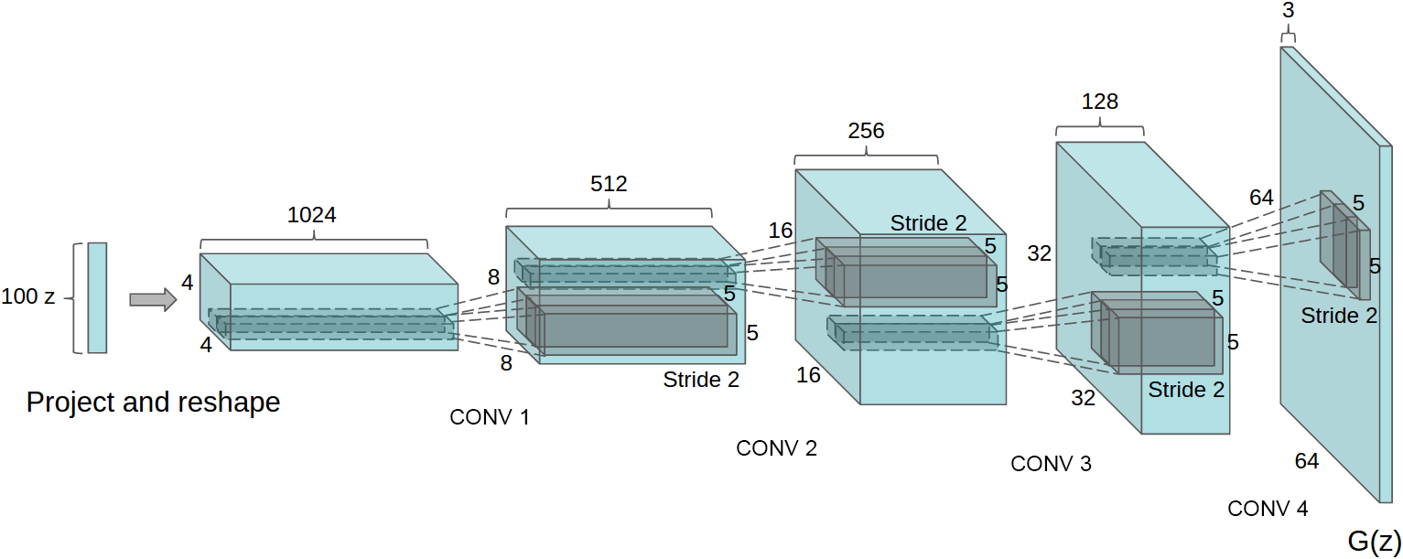
A 100 dimensional uniform distribution Z is projected to a small spatial extent convolutional representation with many feature maps. A series of four fractionally-strided convolutions (in some recent papers, these are wrongly called deconvolutions) then convert this high level representation into a 64 × 64 pixel image. Notably, no fully connected or pooling layers are used.
Unsupervised representational learning with deep convolutional generative adversarial networks
Alec Radford, Luke Metz, & Soumith Chintala arXiv:1511.06434v2

Slide 6
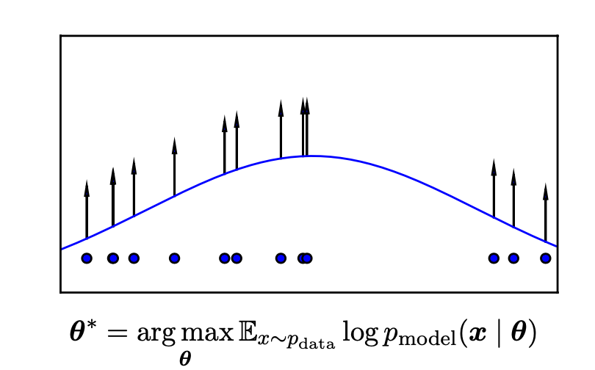
How do generative models work? Goodfellow “NIPS 2016 Tutorial: Generative Adversarial Networks” arXiv:1701.00160

Slide 7
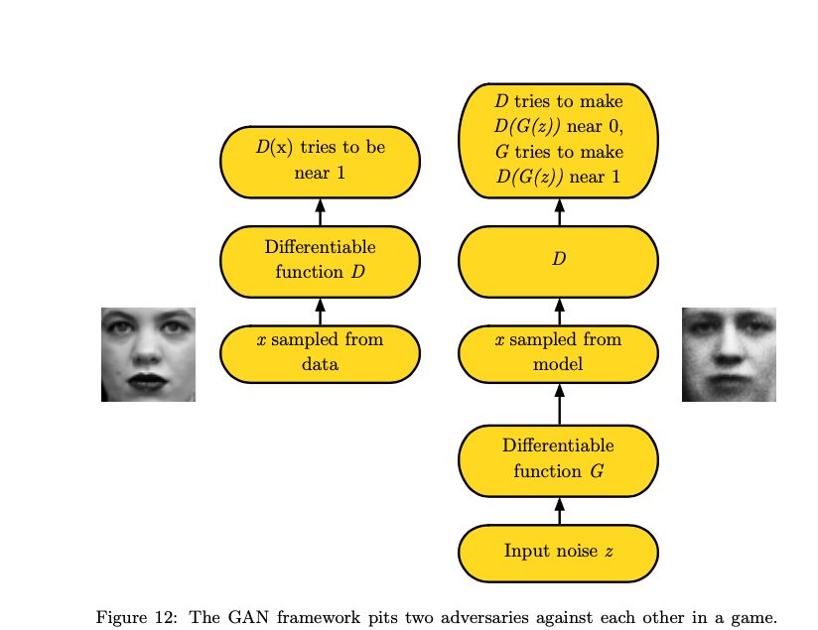

Slide 8
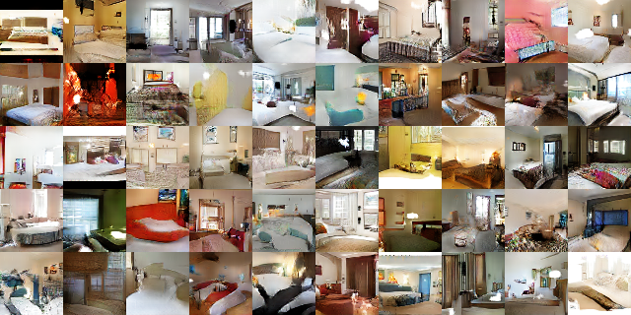

Slide 9
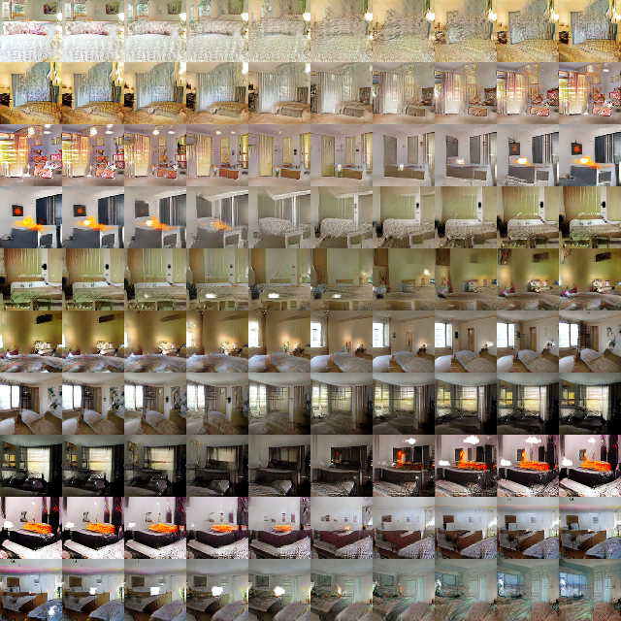

Slide 10
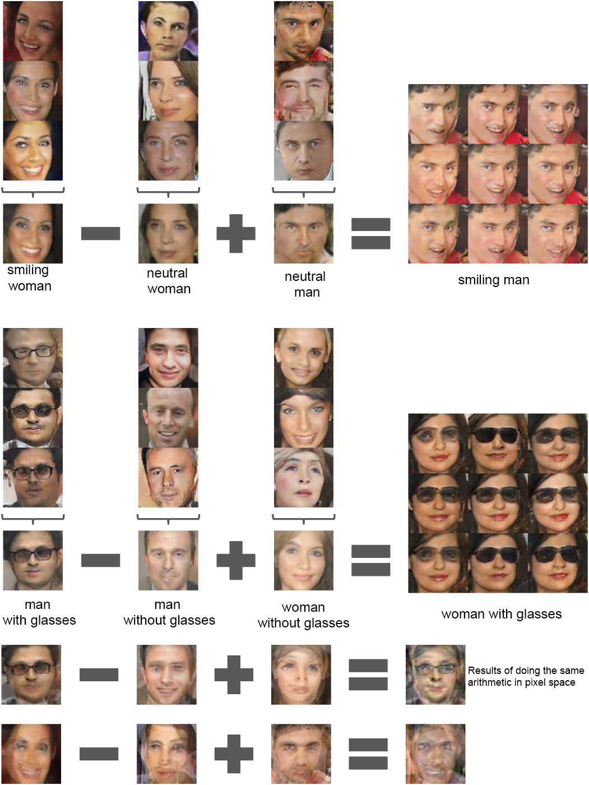

Slide 11
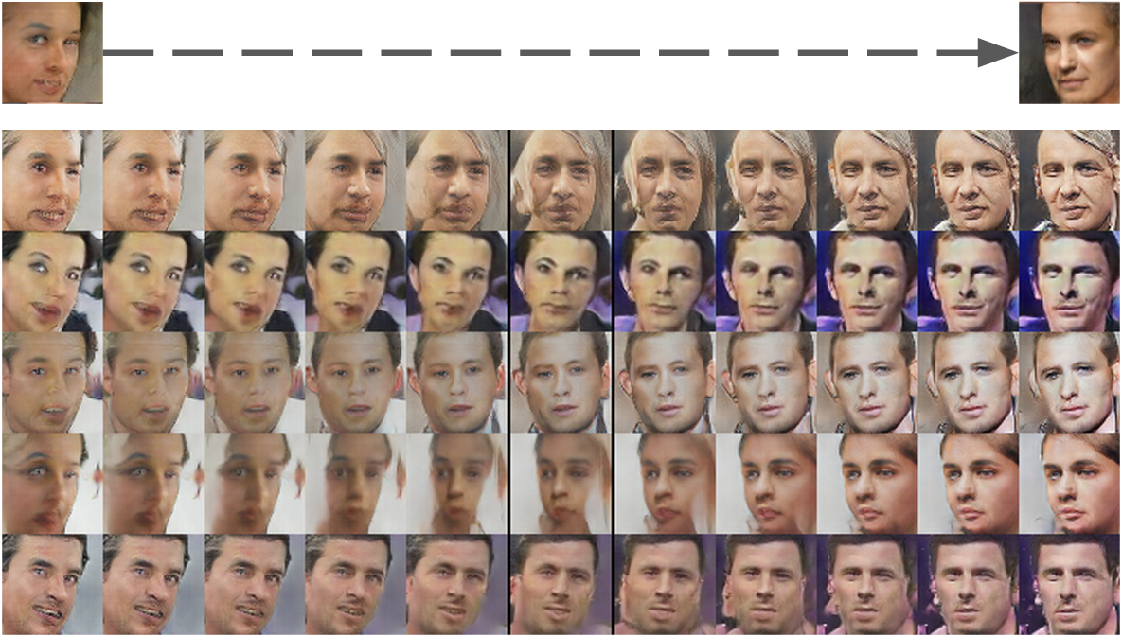
Unsupervised representational learning with deep convolutional generative adversarial networks
Alec Radford, Luke Metz, & Soumith Chintala arXiv:1511.06434v2

Slide 12
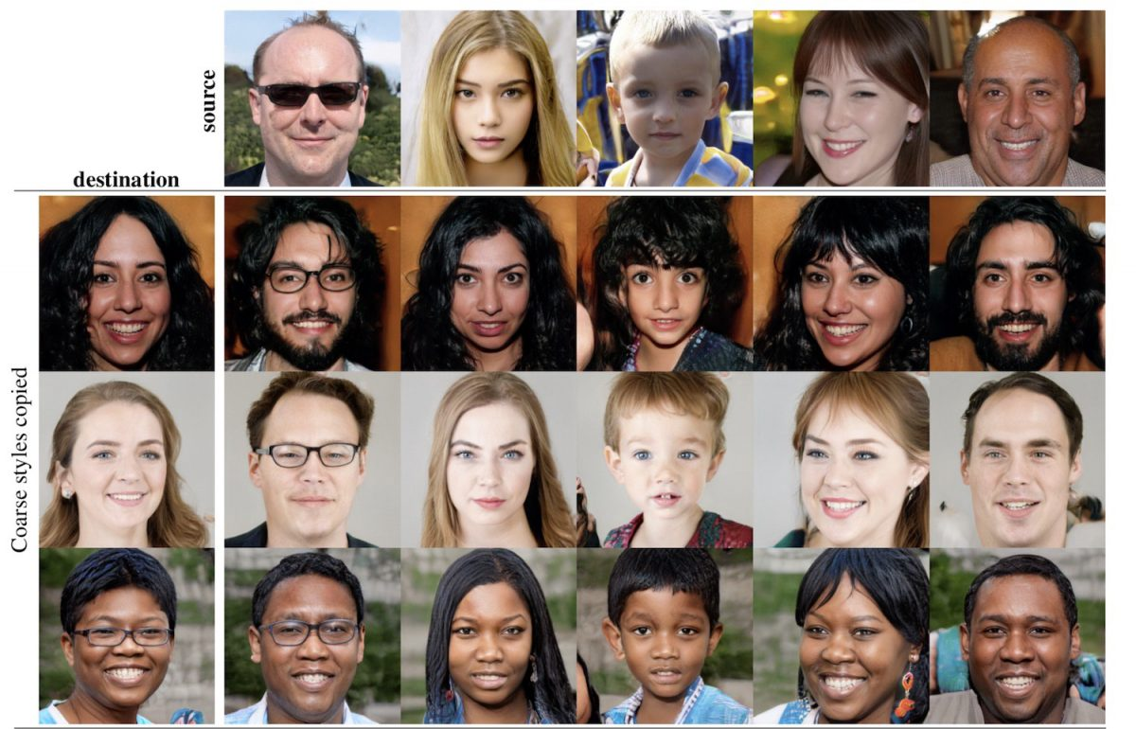

Slide 13
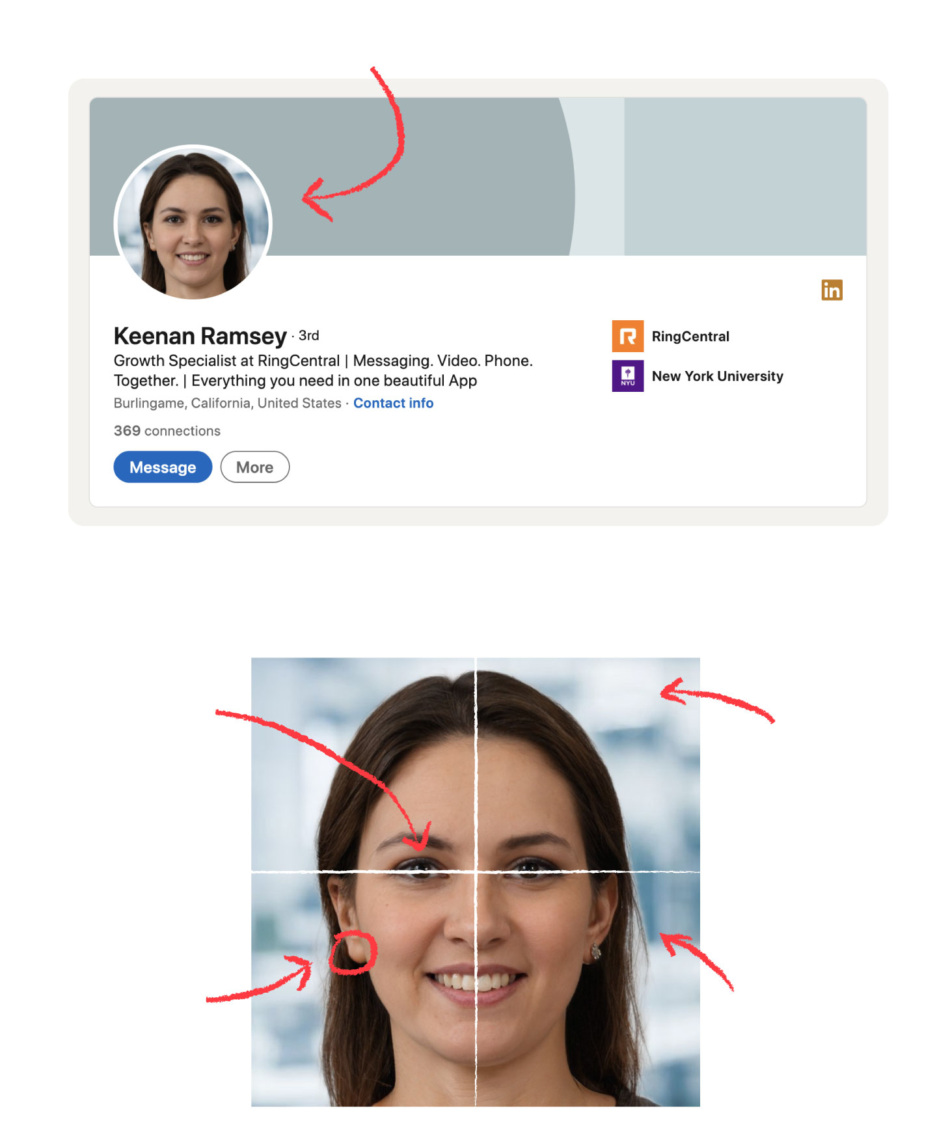
This person does not exist
https://this-person-does-not-exist.com/en

Slide 14
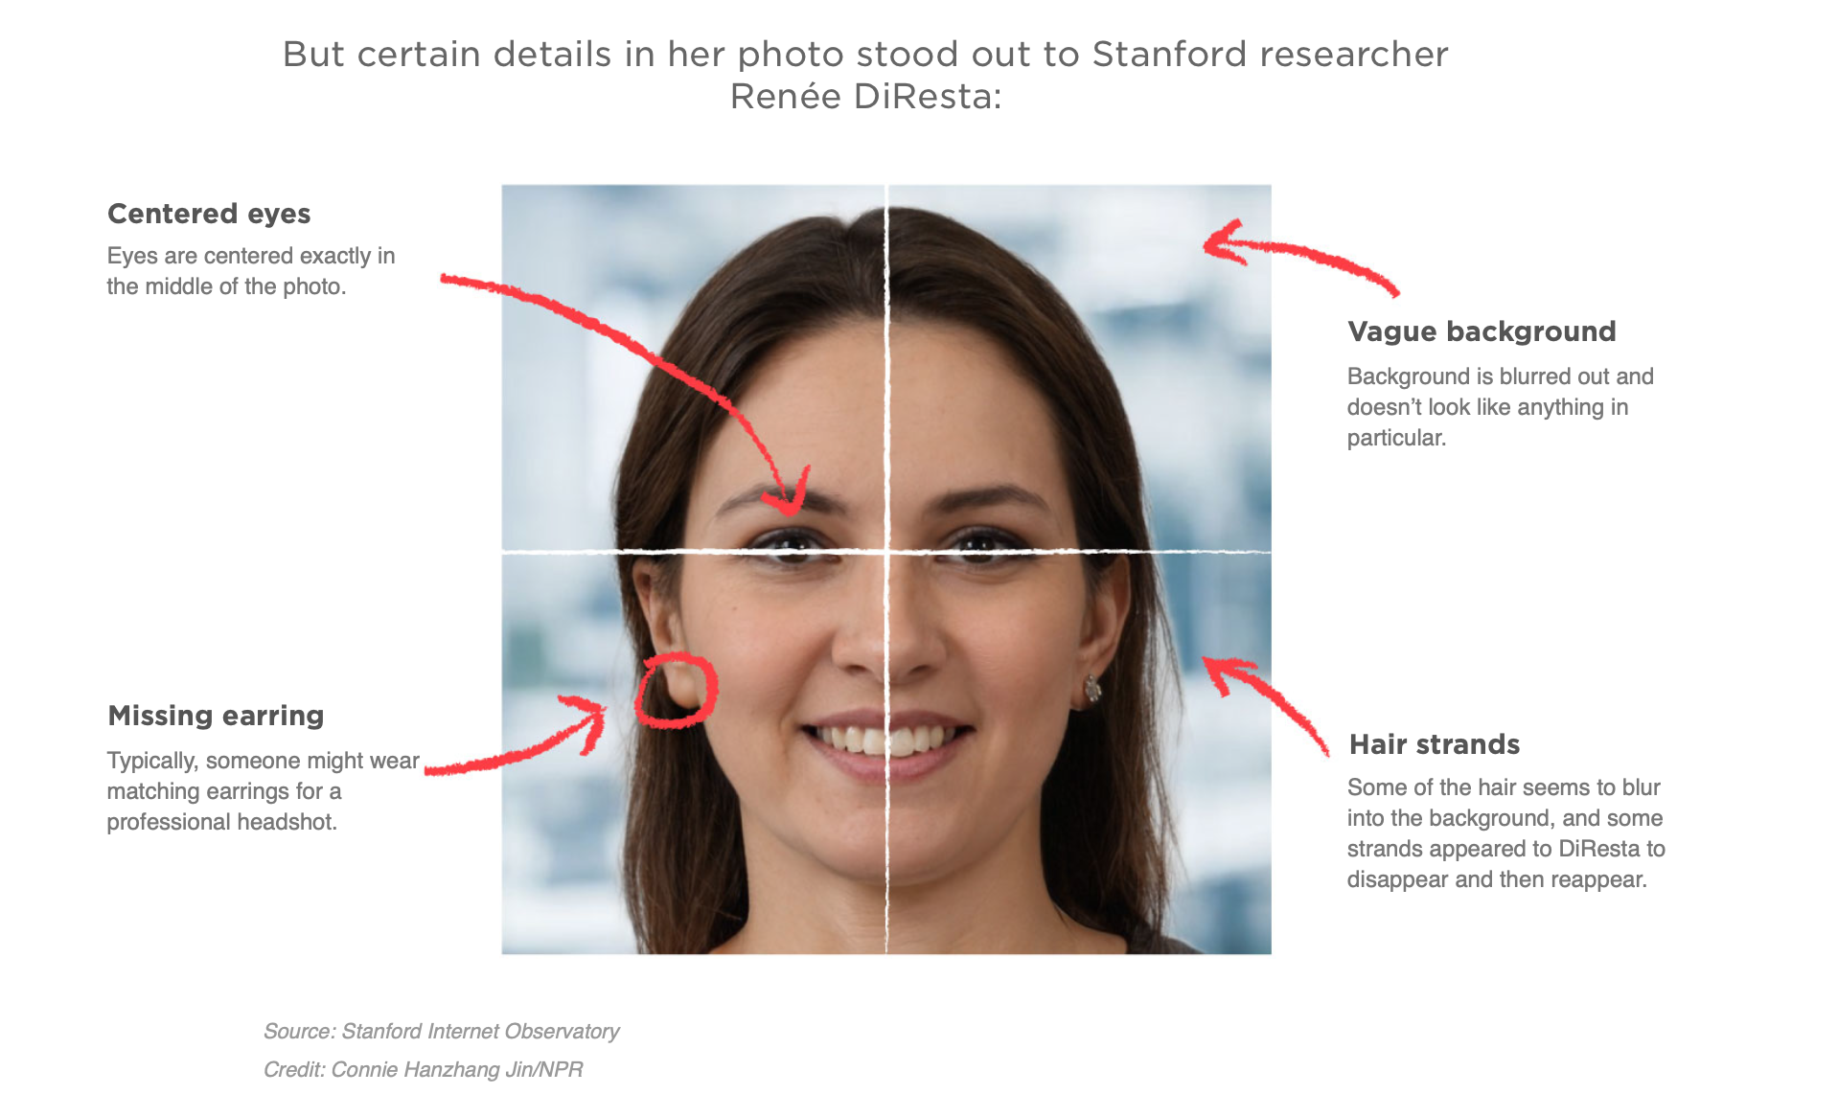

Slide 15
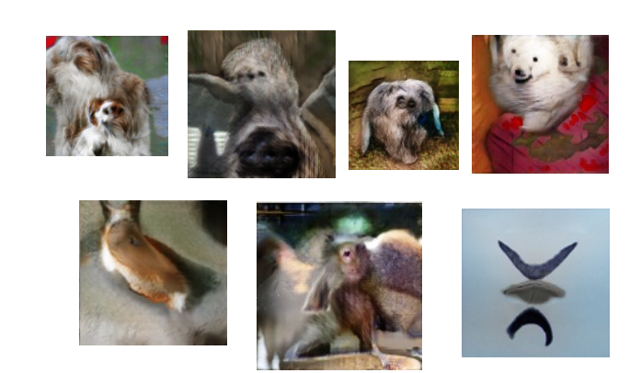

Slide 16
Conditional GANs
Instead of [data] generation de novo, conditional GANs make synthetic data that is intended to seamlessly match with hints or constraints on the output.
Interactive image generation demo:
https://www.youtube.com/watch?v=9c4z6YsBGQ0

Slide 17
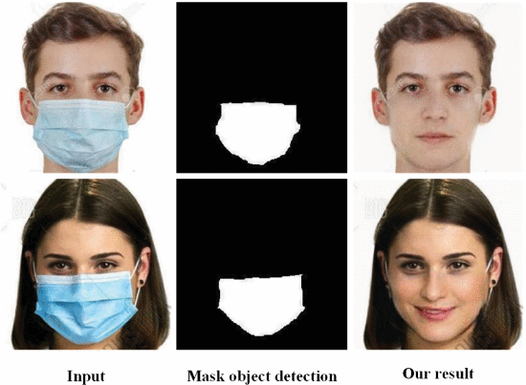
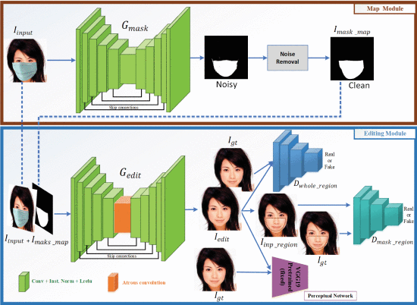
Din 10.1109/ACCESS.2020.2977386 A Novel GAN-Based Network for Unmasking of Masked Face

Slide 18
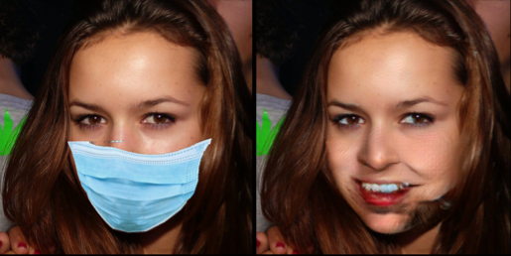
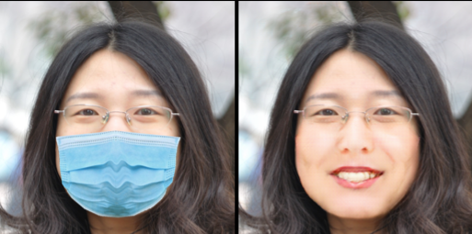
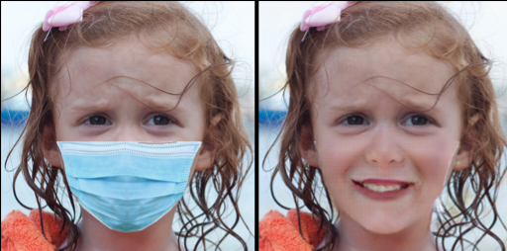
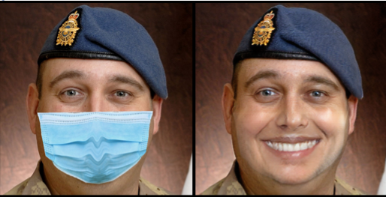

Slide 19
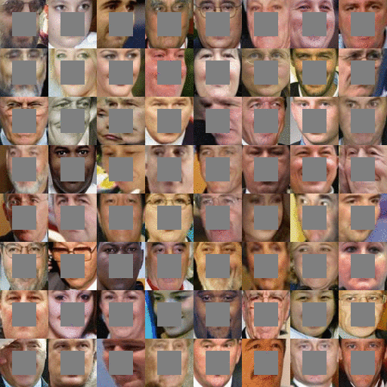
image completion task
easy to generate training data!!!
If you can remove masks and square boxes, you can also train networks to add (or remove) clothing.
https://bamos.github.io/2016/08/09/deep-completion/

Slide 20
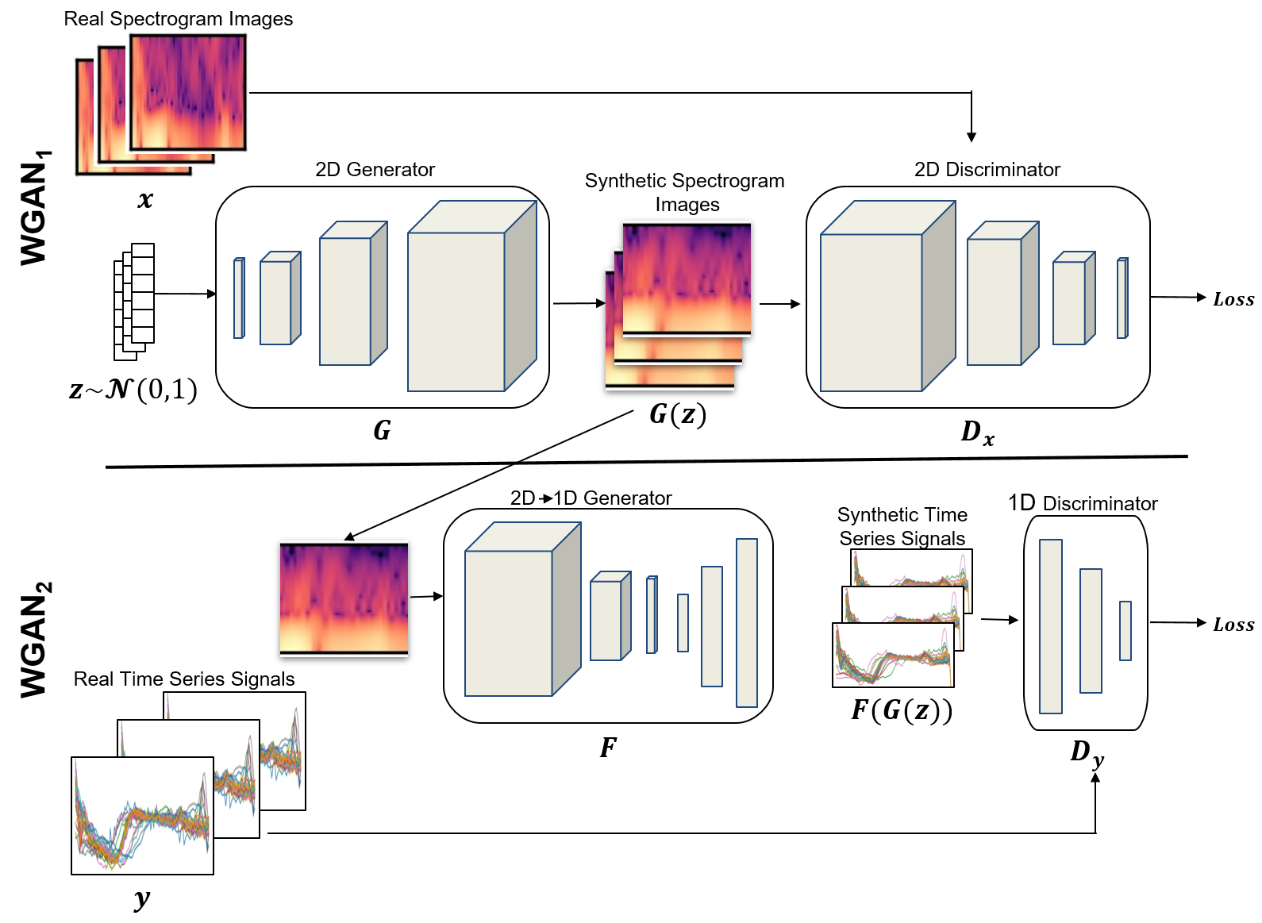
One set of tricks adapts models to domain (convolution, recurrence, attention)
Spectra, images, text…
Another set of tricks stabilizes the networks and makes training faster and hopefully more robust

Slide 21
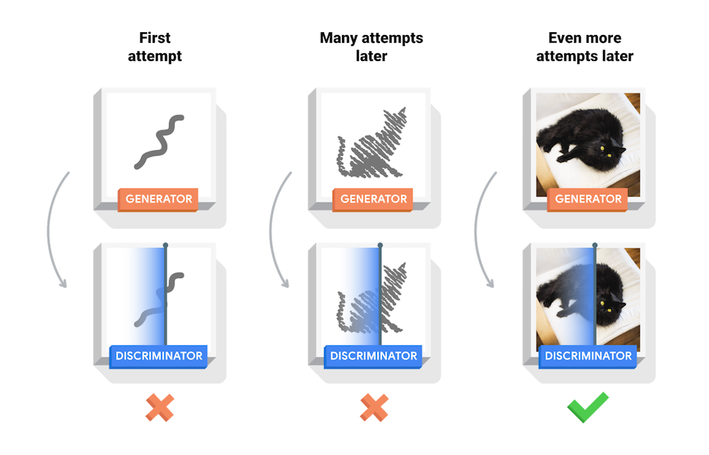
Google tensorflow documentation Deep convolutional GAN example
https://github.com/tensorflow/docs/blob/master/site/en/tutorials/generative/dcgan.ipynb
https://www.tensorflow.org/tutorials/generative/dcgan
Runs ok but takes too long
on my laptop.

Slide 22
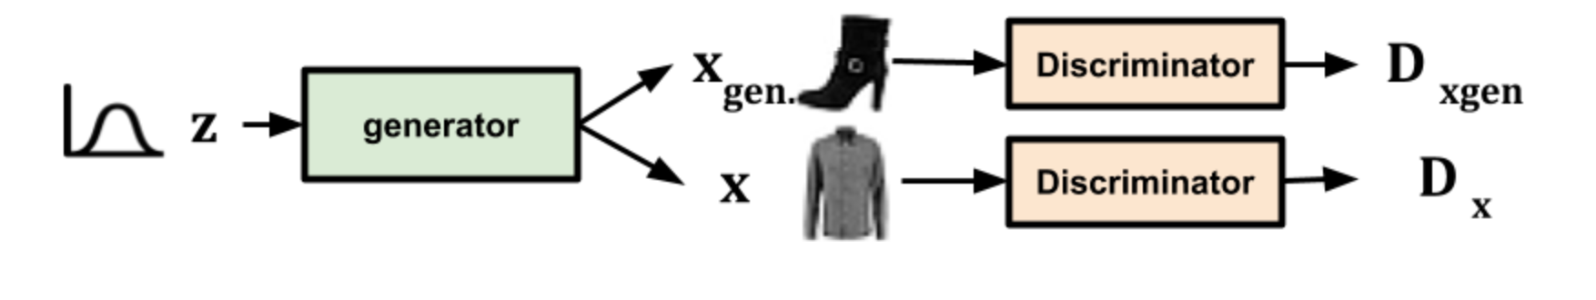
Google tensorflow documentation Deep convolutional GAN example 2.0
https://colab.research.google.com/github/timsainb/tensorflow2-generative-models/blob/master/2.0-GAN-fashion-mnist.ipynb#scrollTo=mojg3wW2G2QC

